Slide 1

NBA
National Basketball Association

Slide 2
OBJECTIVE :
To predict the success of basketball teams in the National Basketball Association (NBA).
Arranging the players according to their teams and each player
Averages and their Statistics
We Arranged team conference rank instead of overall rank since, for discussion purposes, intra-conference standings are generally what people care about the most. All of this can be found in the Teams table.

Slide 3

TEAM DETAILS AND ROLES
NOTE:
To change images on this slide, select a picture and delete it. Then click the Insert Picture icon
in the placeholder to insert your own image.
2000090003 – AFZAL SHAIK
ROLE : Finding the appropriate dataset to work with and import the required libraries
2000090062 - R. SHIVA RAM
ROLE : Exploratary data analysis On the dataset and cleaning the data
2000090061 – Are JAIDEEP
ROLE : To understand the datavisualization is one of the important step

Slide 4
Impact Using Deep Learning
The increasing amounts of data available across different sources and the speed at which organizations and consumers produce new data.
The old personalization methods focused on developing business rules using methods like segmentation, which typically didn't address a particular individual customer.
Recent advancements in specialized hardware (read the GPU and cloud computing) and the growing toolkits for ML and DDL allow us to build customized customer-specific personalization that can be scaled.

Slide 5
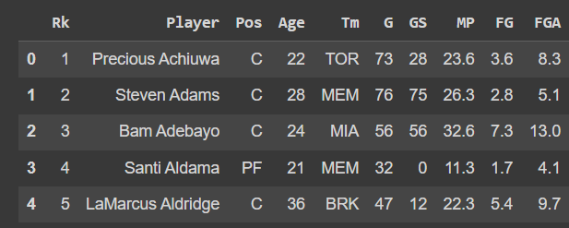
About the Data
The data set contains over two decades of data on each player who has been part of an NBA teams' roster
It captures demographic variables such as age, position, team and rank, biographical details like the team played for, player average and round.
In addition, it has basic box score statistics such as games played, average number of points, rebounds, assists, etc.

Slide 6
Algorithms Used.
For this project we will be going to use deep learning concepts like artificial neural networks and convolutional neural networks as a tool for predicting the success of basketball teams in the National Basketball Association (NBA).
Statistics for 620 NBA games were collected and used to train a variety of neural networks such as feed-forward, radial basis, probabilistic and generalized regression neural networks

Slide 7
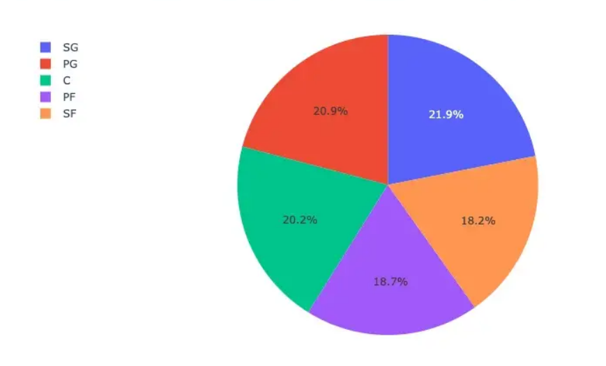
DATA VISUALIZATION :
In this Visualization we can see the data is about different positions of the player

Slide 8
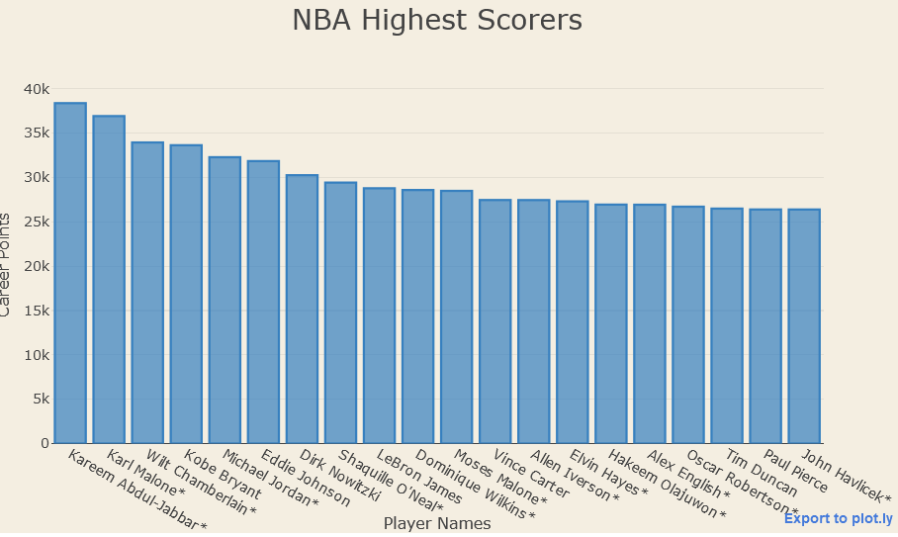
DATA EXPLORATION
Here an example
NBA Highest Scorers
0k to 40k carrier points

Slide 9
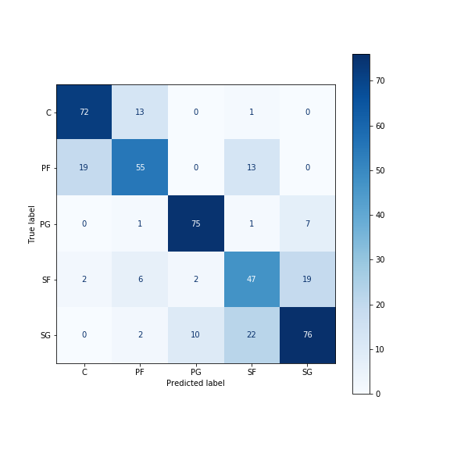
Confusion matrix :
We can observe the misclassifications in the confusion matrix plotted below
The misclassification rate shows how often your confusion matrix is incorrect in predicting the actual positive and negative outputs

Slide 10
CONCLUSION :
Finally, we observe in the confusion matrix that most of the misclassifications are happening between the classes Rank , position , team and player average.
For this project , Our Random Forest Regression model, with parameters optimized through RandomSearchCV, gave us the highest testing accuracy of 67.15%.
It is slightly higher than the Logistic Regression model, and it is much higher than the Linear Regression model based on individual player statistics.

